Slide 1


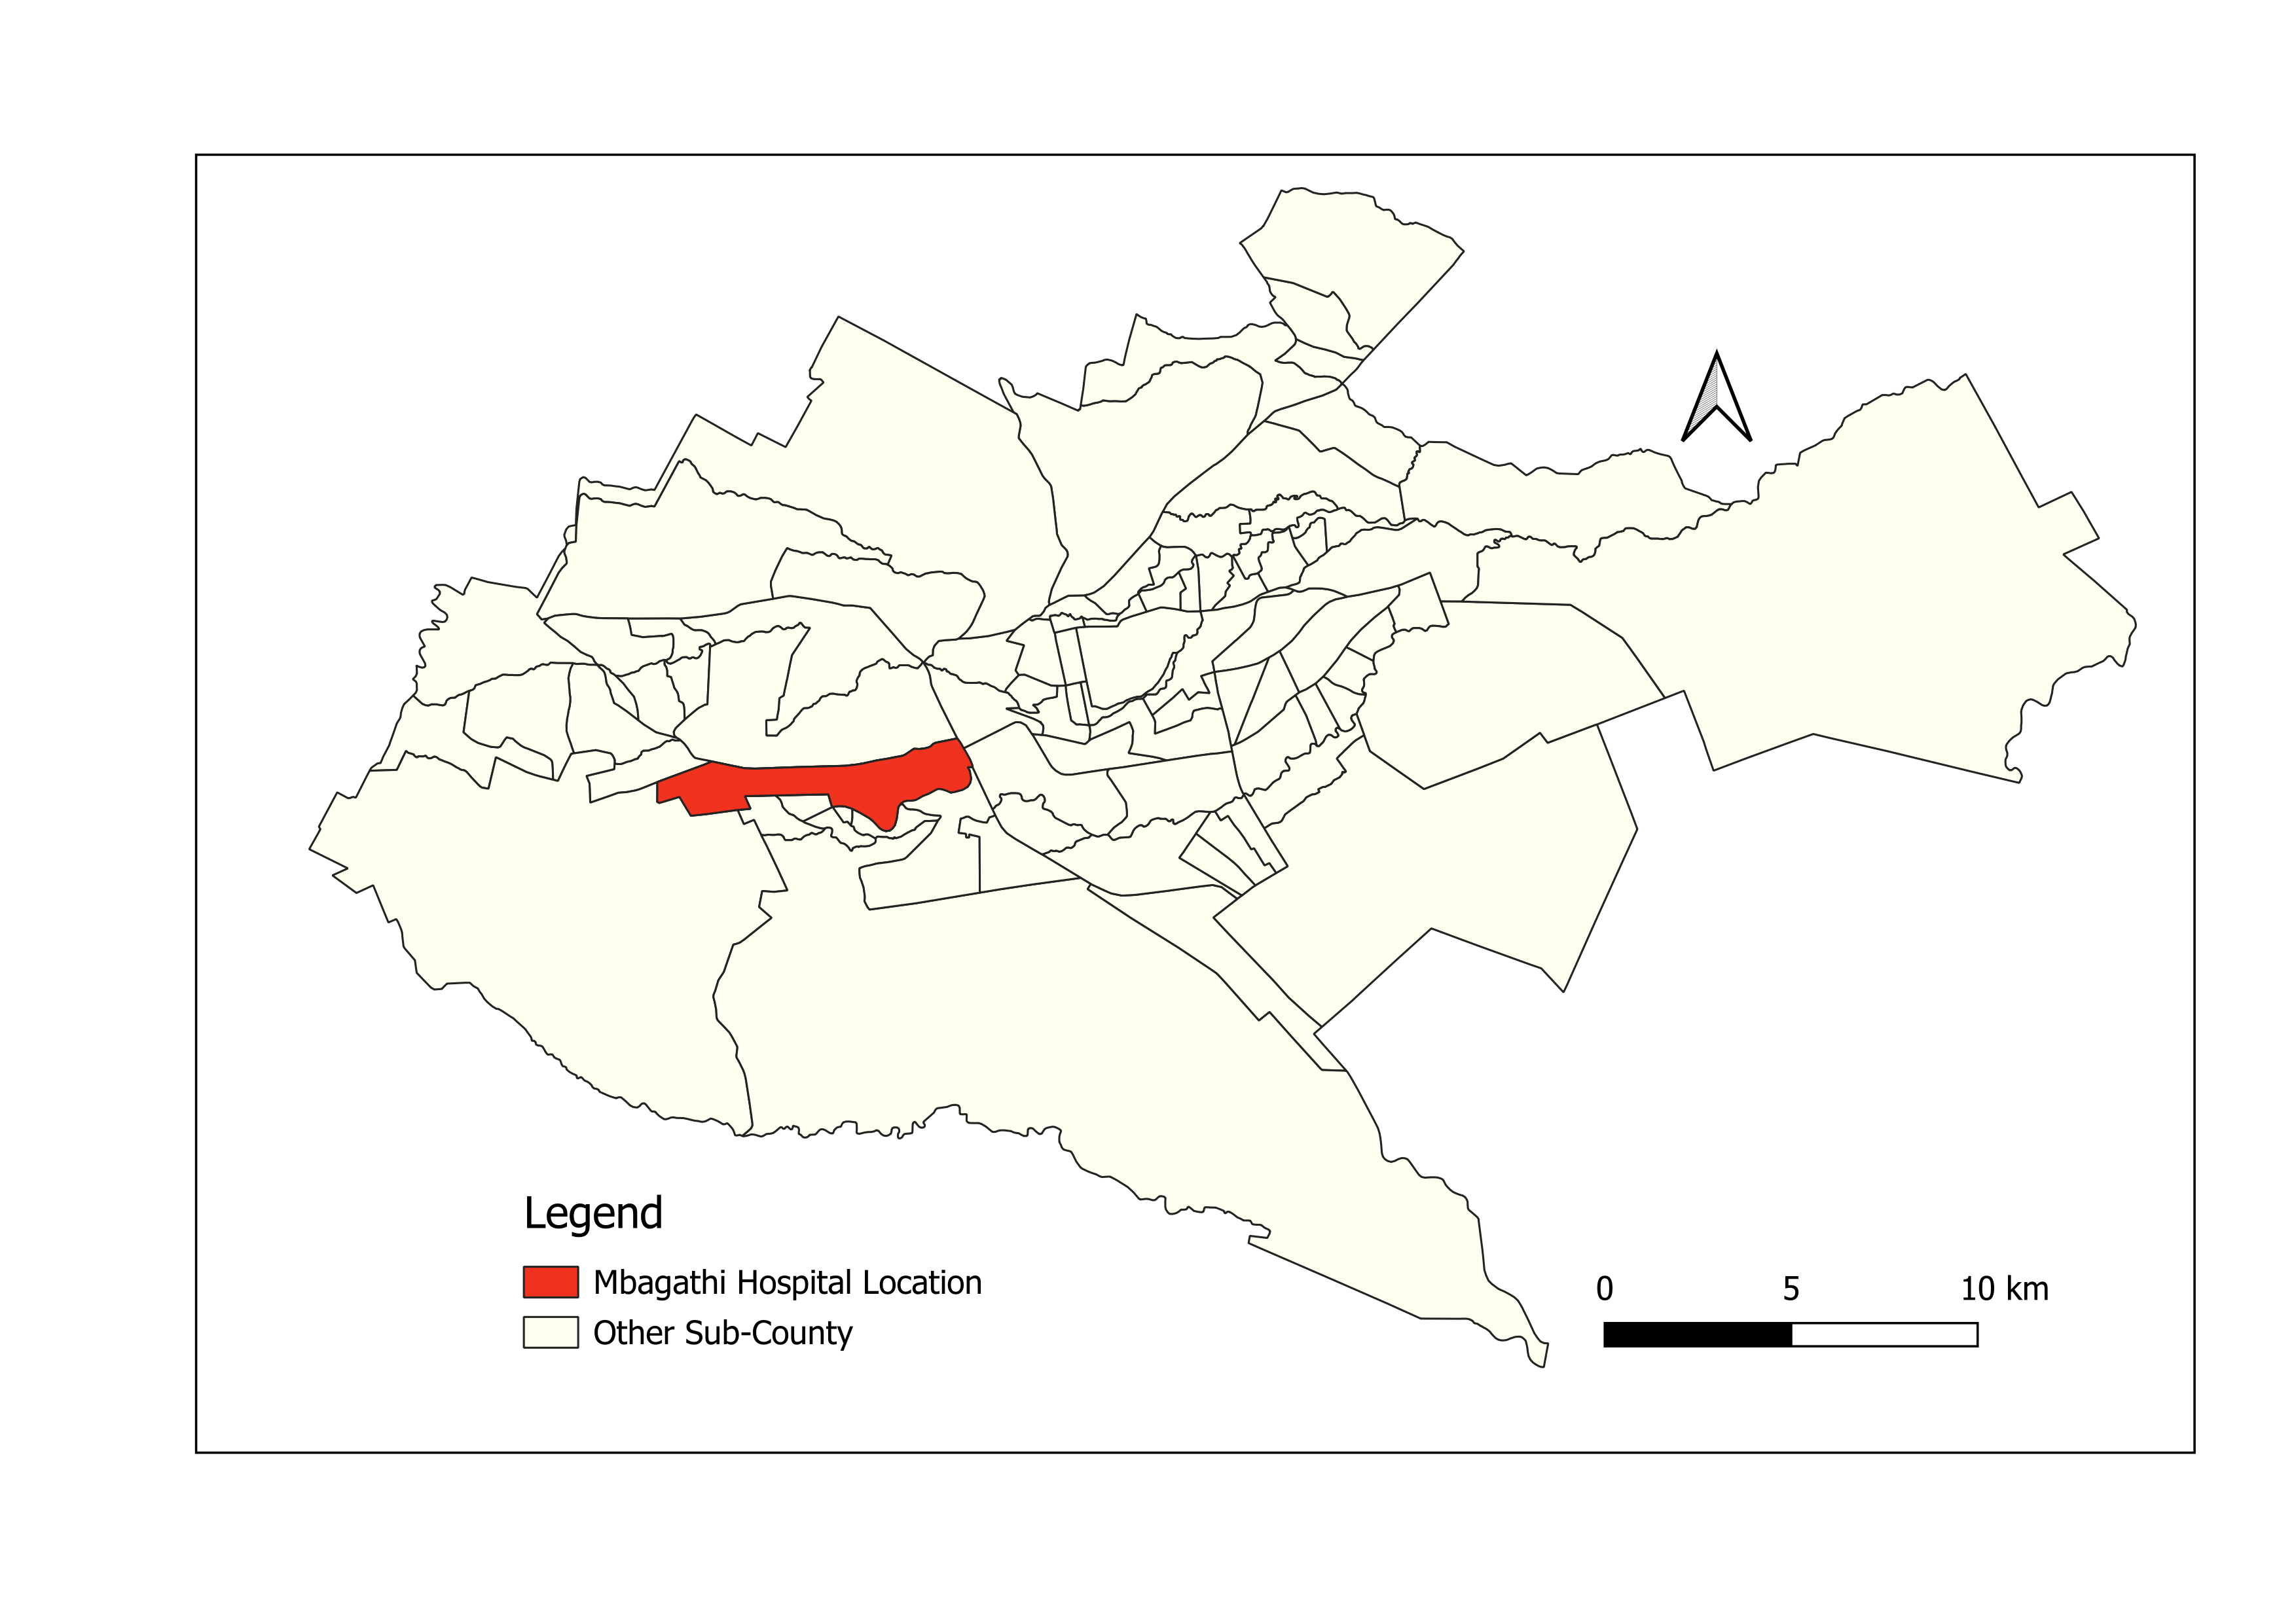
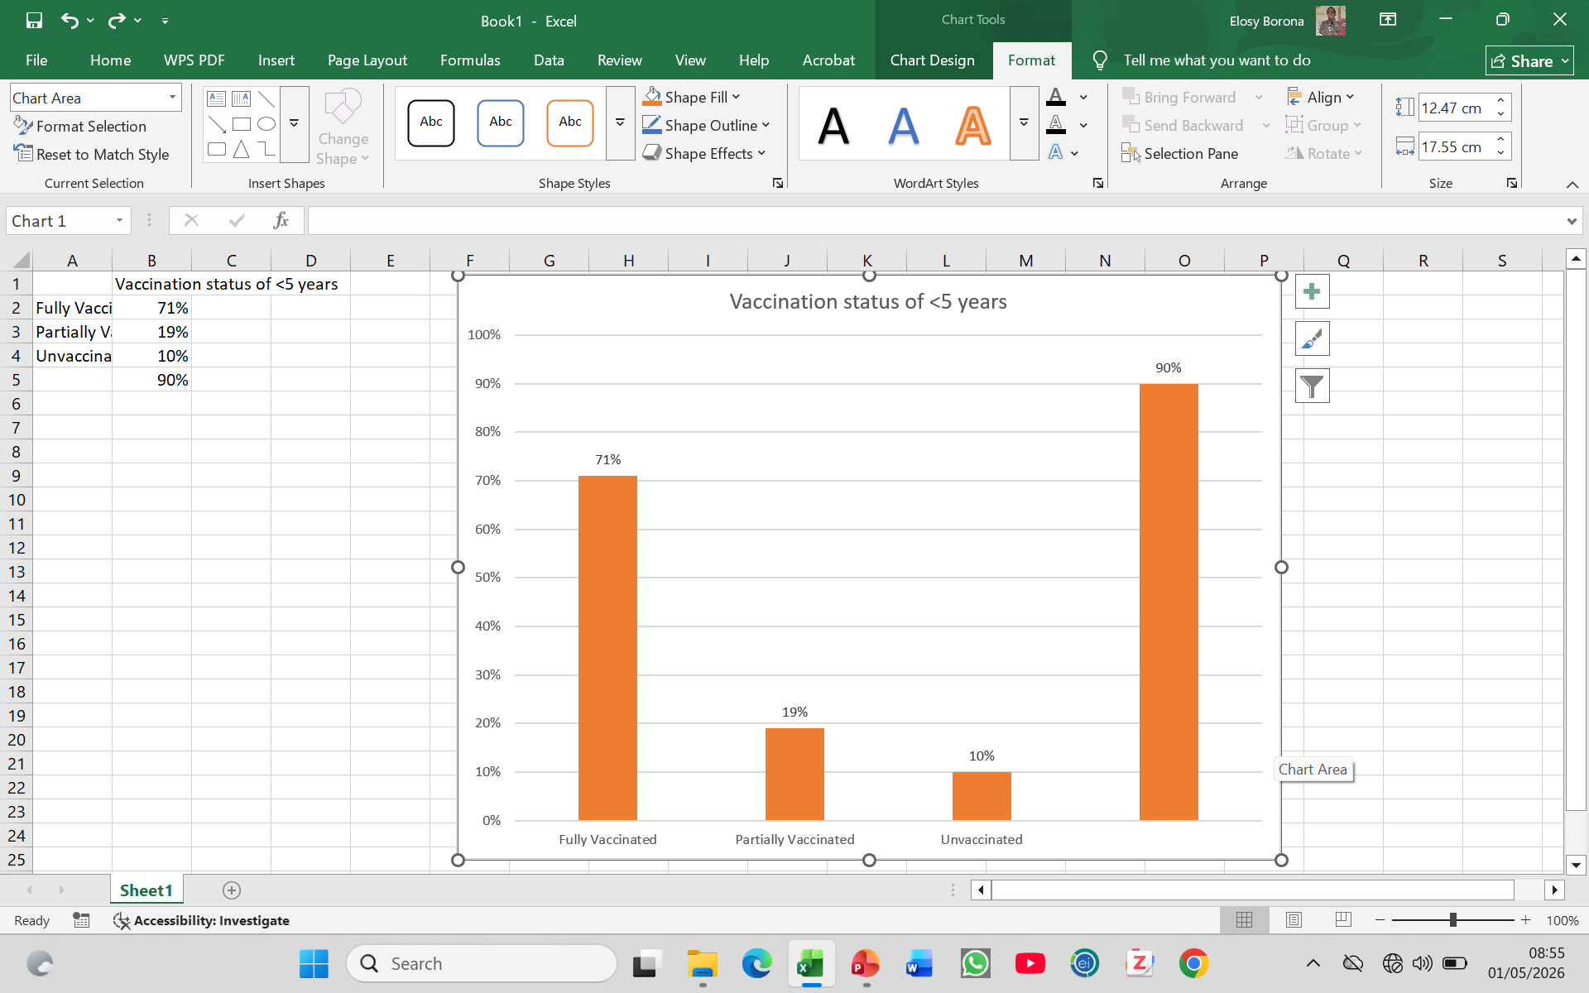


Evaluation of the Rotavirus Surveillance System for Children Under Five Years at Mbagathi Hospital, Nairobi County, Kenya 2026
Elosy Borona^{1,}, Caroline Mbogori ¹, Jane Githuku ², Maurice Owiny ², Athman Mwatondo ²
¹Field Epidemiology and Laboratory Training Program, Kenya National Public Health Institute
²African Field Epidemiology Network
BACKGROUND:
Rotavirus causes 25 million outpatient visits and 2 million hospitalizations each year
In Kenya, rotavirus trends are monitored using data from sentinel surveillance
We evaluated the Rotavirus surveillance system in Nairobi County to assess its performance and characterize cases reported through the system
OBJECTIVE:
To evaluate the Rotavirus surveillance system in Nairobi County, to assess its performance and characterize cases reported through the system.
METHODOLOGY:
We Abstracted Rotavirus case data from surveillance registers and laboratory records and administered semi structural questionnaire to assess surveillance system attributes as define in the Us CDC framework evaluation.
STUDY AREA: Mbagathi Hospital, sentinel site.
STUDY DESIGN AND SAMPLING:
Key Informant Interviews were conducted using a questionnaire developed using Kobo Collect.
The questionnaire were administered to the national rotavirus surveillance focal person and other system users at the Mbagathi sentinel site
DISCUSSION:
Figure 1: Location of Mbagathi hospital
The system remains useful for monitoring disease burden and effectively described rotavirus burden by person, place, and time
Vaccinated cases reflected high vaccine coverage,high acceptability, strong integration with national systems, and adequate laboratory capacity.
Reagent stock-outs, incomplete training coverage, and weak feedback mechanisms posed operational challenges.
RESULTS:
Table 1: Evaluation of Key System attributes
Attribute | Key Metric | Finding (n=21) | Percentage
Flexibility | Accommodates changes | 15 | 71.4%
 | CIF changed in last 3 years | 13 | 61.9%
Stability | Experienced outage (last month) | 8 | 38.1%
 | System stable after maintenance | 19 | 90.5%
Simplicity | System Moderately simple | 12 | 76.2%
Acceptability | Willing to participate | 21 | 100%
CONCLUSIONS:
The rotavirus surveillance system were functional and useful in guiding the National Immunization Program by monitoring of vaccine impact.
There is need to Strengthening timeliness of reporting and continuous staff training.
Improve system performance and outbreak preparedness.
Continue strengthening integration with other surveillance systems such as IDSR
figure 2:Vaccination status of the < 5 years
………
Contact: [Insert Email]
Contact details:elosybel@gmail.com

